Slide 1
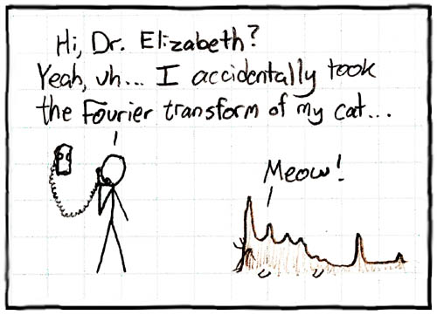
The Chirp Z-transform; Fourier transforms
over sensible ranges
for fun and profit.
xkcd.com/26
Notes:
Two weeks ago, you heard Mehrnaz give a fantastic talk on topic which, without question, will affect all Canadians, and potentially the whole world, for thousands of years. This is especially timely as the Biden administration and 24 other countries pledged to triple the global capacity of nuclear power.
My hope for this talk is much more audacious. I want to describe an algorithm which provides no benefits and should never be used in any reasonable situation.

Slide 2
I am not a signal theorist
this talk should not be construed as legal advice and has not been approved by the FDA for the treatment of any medical condition
Notes:
So first a disclaimer - as with many ugly and incompletely understood things, this talk was borne from an application.
Talking about things you’re not an expert in is often fraught.
Not the right person to talk about the fourier transform. Charan, Scott - there are people with PhDs in the fourier transform here.

Slide 3
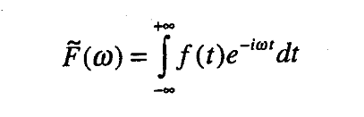
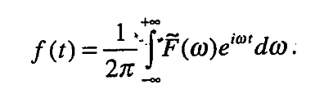
a refresher
A scientist in possession of good data must be in want of a frequency-domain representation of that data.
Jane Austen
Notes:
Since basically every field of science involves periodicity in time or space, this shows up everywhere.
You can use this analytically.

Slide 4
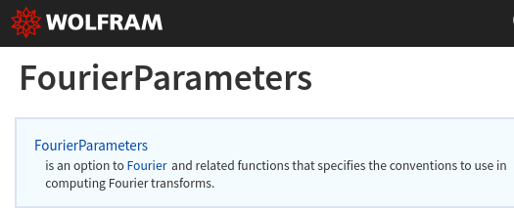
Notes:
Whether you use angular frequency or Hz
Whether or its complex conjugate
Whether you normalize the output by the time-step

Slide 5
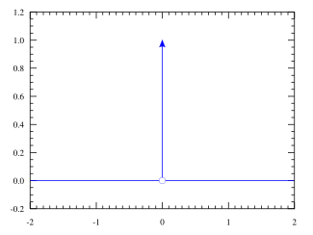
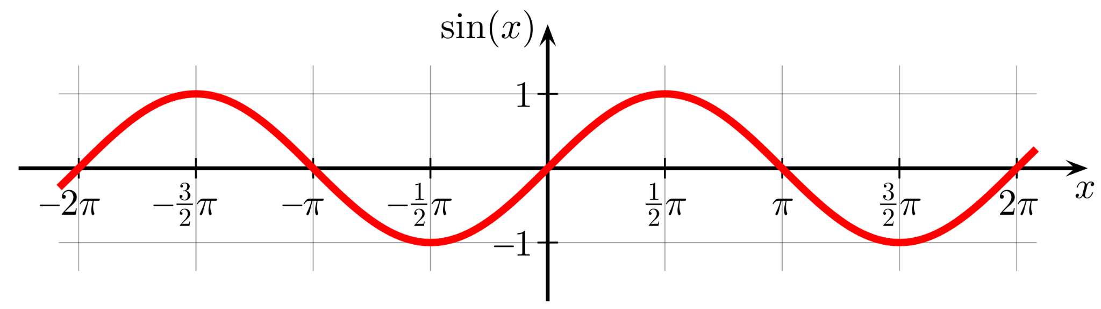
a refresher
Notes:
Delta function.

Slide 6
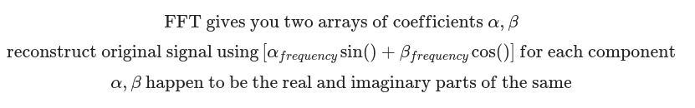
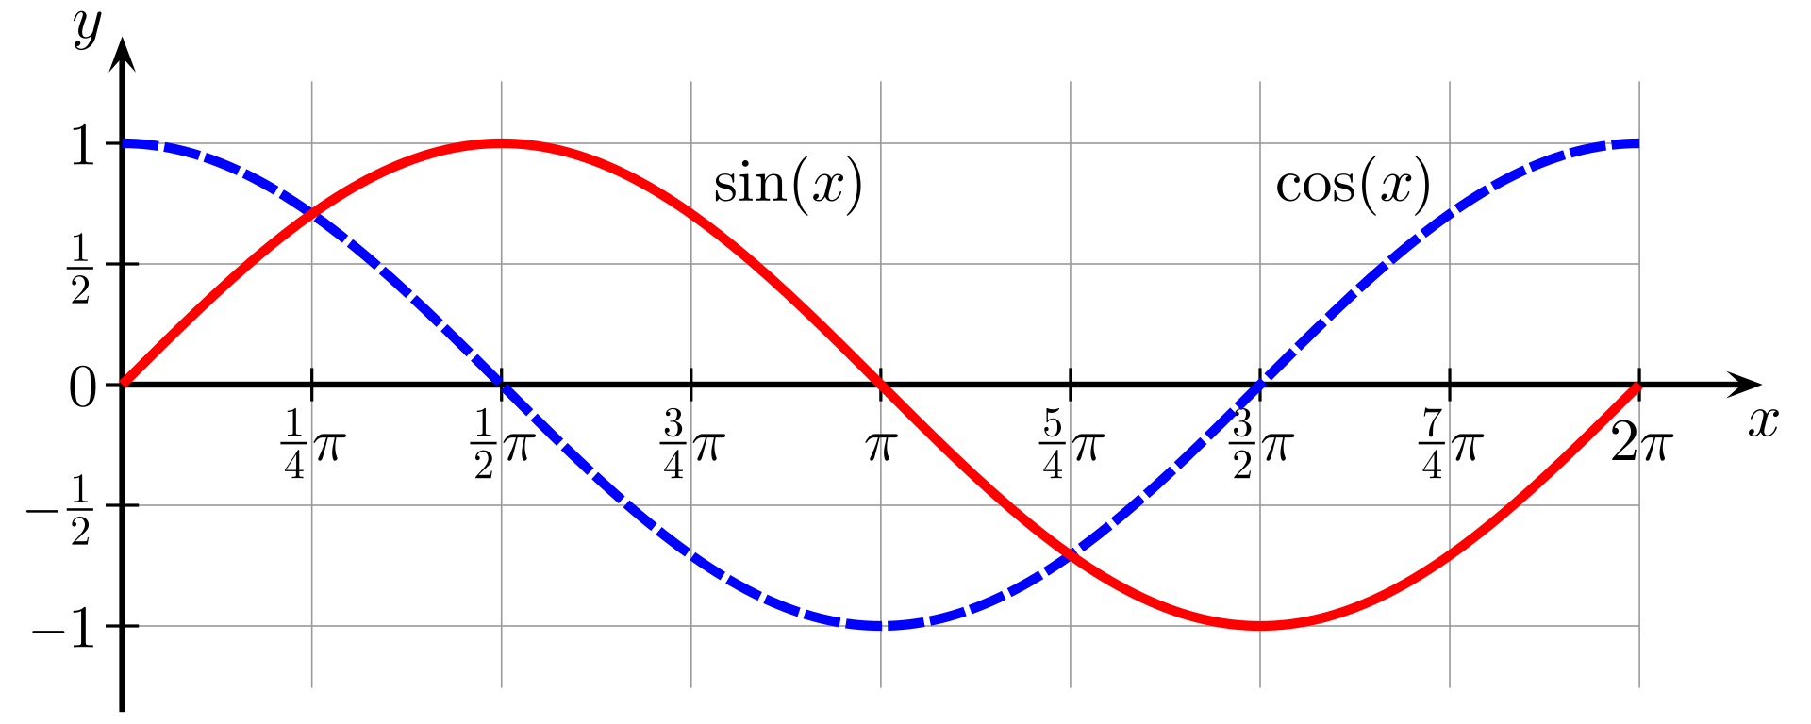
(wrong) intuition: two arrays

Slide 7
Continuous / Analytic: |  | Discrete version:
Laplace transform | “Good for damped pendulums.” I understand that this can be thought as fourier transform supporting exponential variation with time. | Z-transform
Fourier transform | Constant sins and cosines, periodic over all time. | DFT (almost always FFT, Blackman-Tukey in the past)
Bunch of other stuff I guess (wavelet transform, STFT, ... ... ...)
Notes:
Member of a class of related concepts and techniques, the Z-transform.

Slide 8
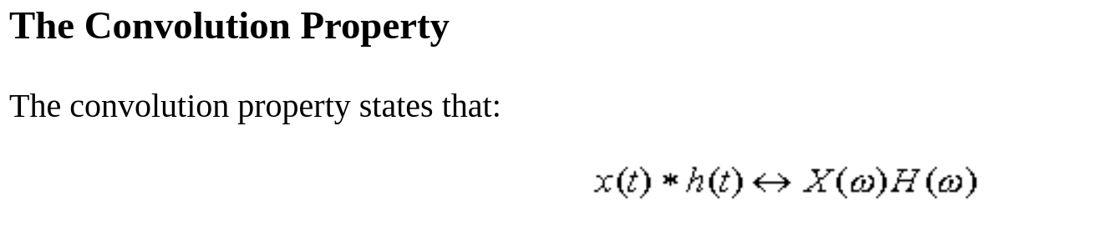
More Properties of the Fourier Transform.
https://class.ece.uw.edu/235dl/EE235/Project/lesson17/lesson17.html

Slide 9
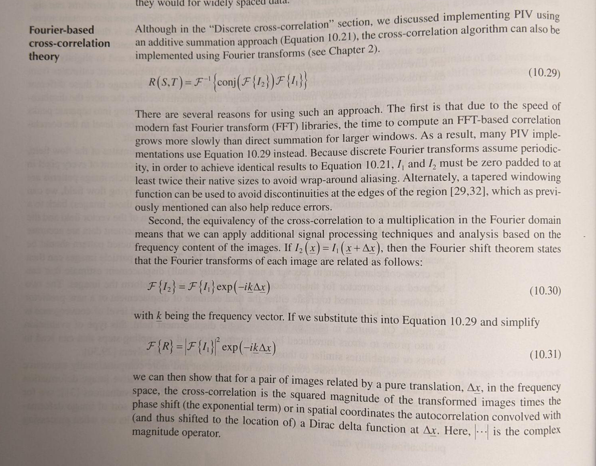
Correlation: Particle image velocimetry
Discetti, Stefano, and Andrea Ianiro. 2017. Experimental Aerodynamics. CRC Press.

Slide 10
Multitaper
[the periodogram, magnitude(fft)^2, is]...the naive spectral estimate, meaning it is the spectral estimate that you get if you don't know that there is something better. Please do not use the periodogram in your publications.
emph. mine
Elipot, Shane. “Lecture 4: Time Series Analyses.” University of Miami. https://selipot.github.io/talks/lecture4.pdf

Slide 11
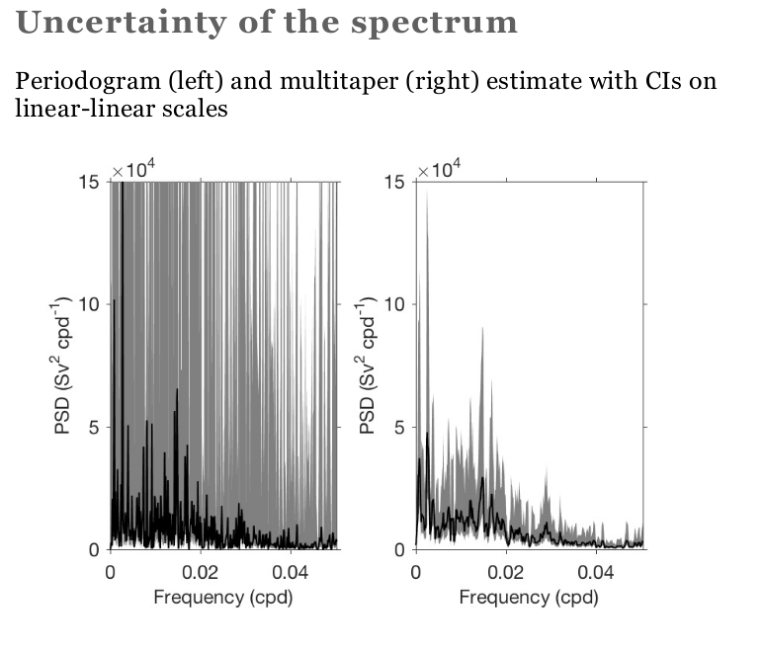
Elipot, Shane. “Lecture 4: Time Series Analyses.” University of Miami. https://selipot.github.io/talks/lecture4.pdf

Slide 12
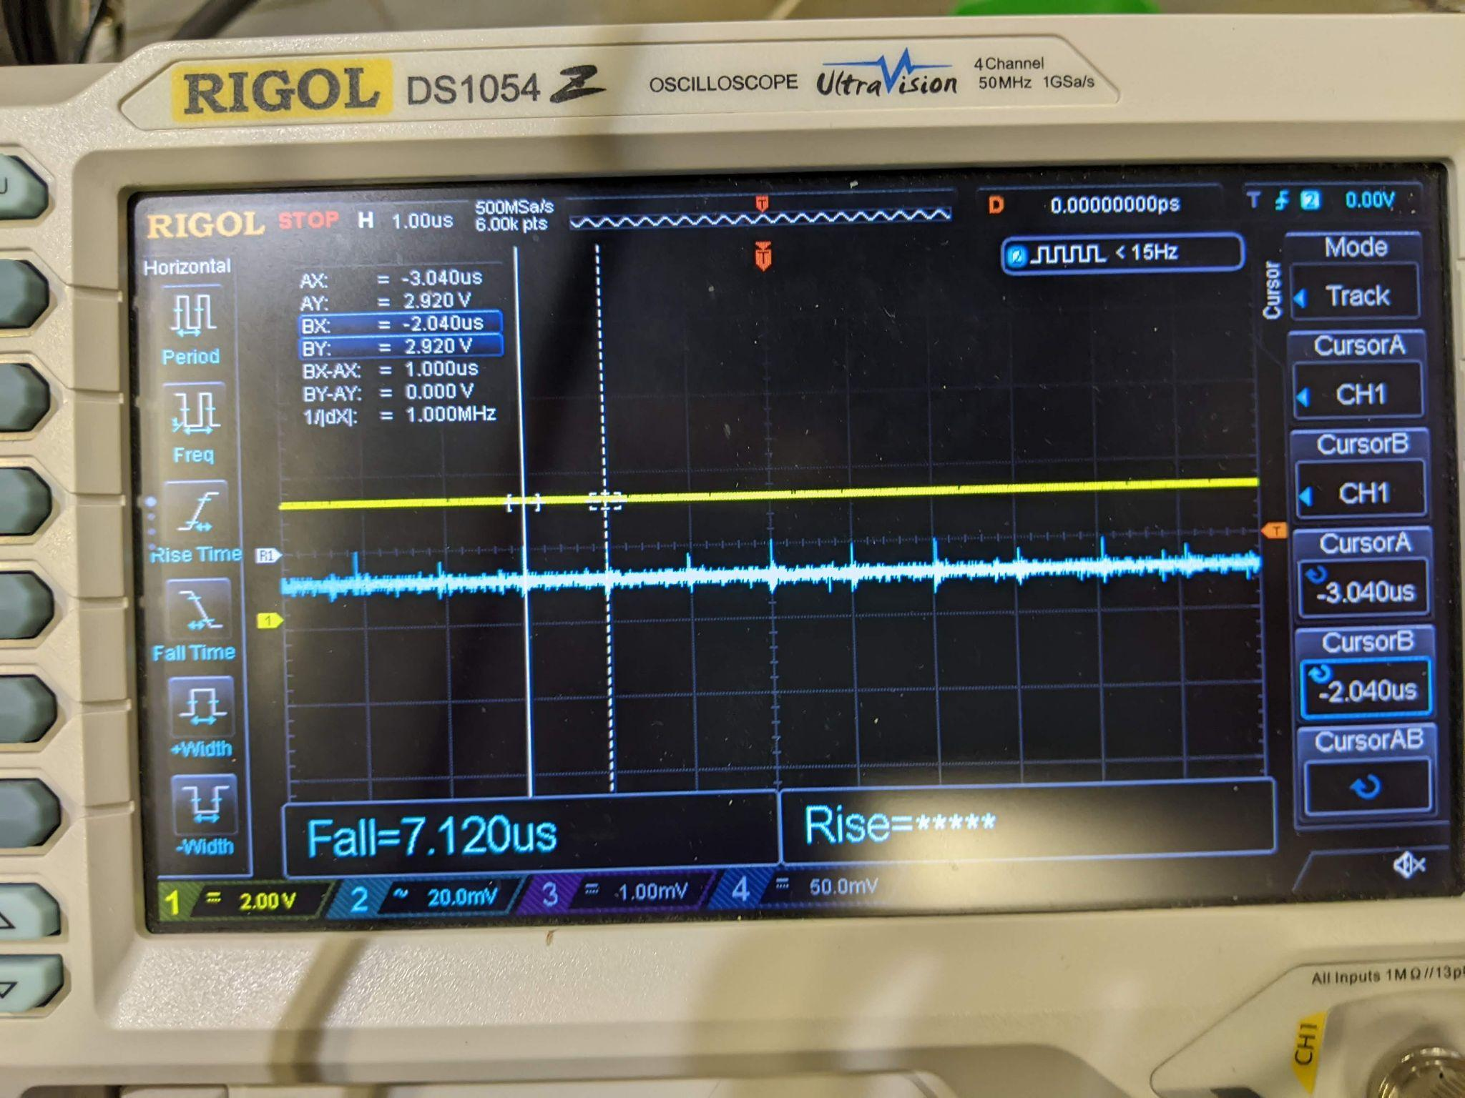
Real example: Tracking down interference
Connect an oscilloscope to a system.
What is the source of interference?
Interested in frequency range
10 to 1000 Hz
60 Hz + harmonics

Slide 13
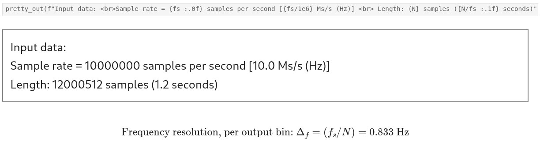
Oscilloscope setup looks sensible enough...

Slide 14
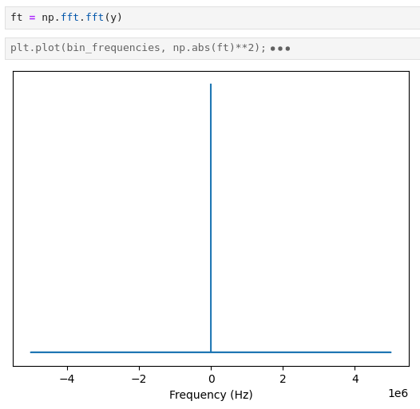

Slide 15
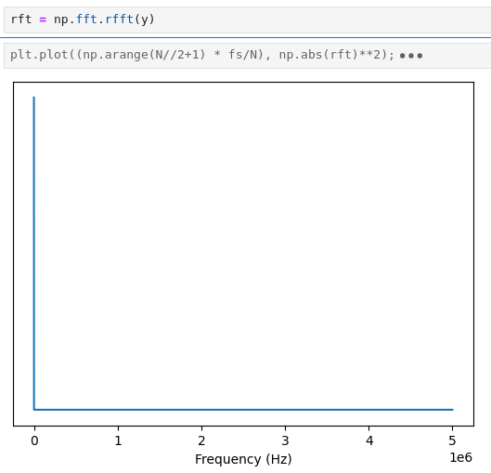
Notes:
Can do a little better if we take the real fft, since the oscilloscope isn’t putting any imaginary components into the FFT.

Slide 16
FFT has a non-negotiable relationship between input and output
Nyquist limit (sample frequency / 2)
Need at least two points per cycle
(although if frequency components higher than the Nyquist are present during measurement, they may still be be aliased into your FFT range!)
Rayleigh frequency (1/T)
need at least one cycle over the whole length of the recording
Intrinsic to the information theory - does not depend on the implementation
(in the past, FFT implementations often also wanted an even power-of-2 input length [or would pad it internally, which is expensive], but with modern libraries this is not usually a concern anymore.)
Notes:
If you haven’t seen a full cycle of the

Slide 17
Using this dataset as an input,
we can easily see the part of the spectrum that we want if we truncate - trim off all the parts we don’t want

Slide 18
But, this only represents 1188 bins of the 6000257 that rfft() gives us (0.019%)

Slide 19
Need to compute and also allocate memory for all those wasted bins

Slide 20
Well, that’s stupid
why did you record it at 10 Ms/s if you only want a 1 KHz signal?
Notes:
In this contrived example, we could simply have zoomed out on the oscilloscope.

Slide 21
Well, that’s stupid.
Just zoom out with the oscilloscope.
Notes:
In this contrived example, we could simply have zoomed out on the oscilloscope.

Slide 22
Well, that’s stupid.
Just zoom out with the oscilloscope.
Why are we even talking about this.
Notes:
In this contrived example, we could simply have zoomed out on the oscilloscope.

Slide 23
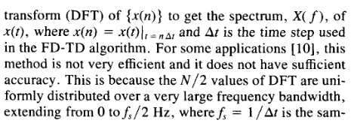
Problem occurs anytime the sample rate and/or record length are poorly matched to the frequency range.
Some settings where you don’t have the flexibility; FDTD, MD
Notes:
In this contrived example, we could simply have zoomed out on the oscilloscope.

Slide 24
Common techniques
Decimate the input
Throw out 9 points, keep every 10th. Artificially decreases the sample rate.
“I spent a month collecting that data, now you want me to throw 90% of it out?”

Slide 25
Common techniques
Pad the input with zeros
Artificially increasing N to change the ratios
Works OK
Enormous increase in computational cost

Slide 26
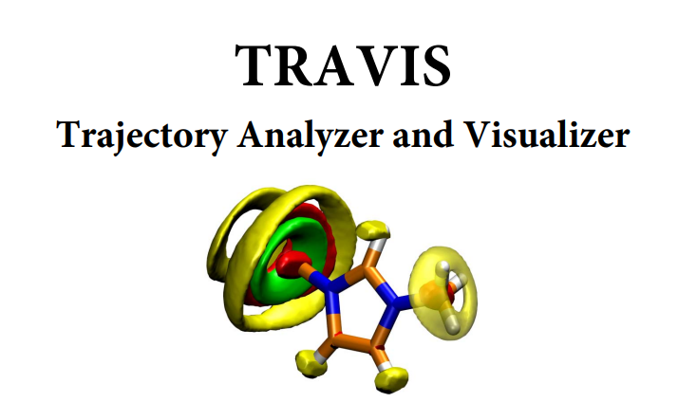
Common techniques
Pad the input
Side effect of creating frequency bins
Sometimes that’s useful, can help in interpreting

Slide 27
Common techniques
Pad the input
Side effect of inventing new frequency bins between
Sometimes that’s useful
Usually just dubious and concerning
New bins don’t contain actual information
Just a sinc() interpolation.

Slide 28
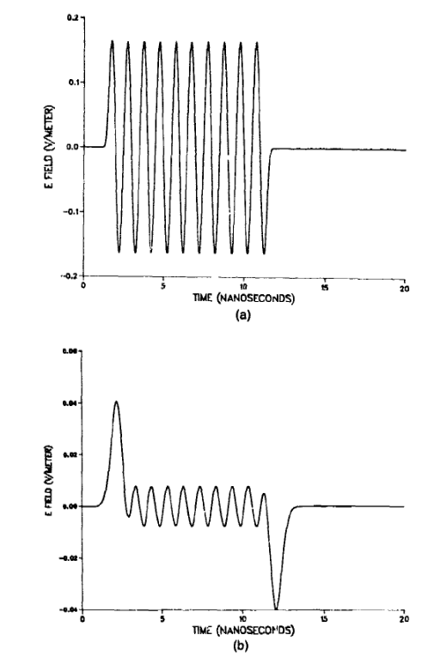
Albanese, Richard, John Penn, and Richard Medina. 1989. “Short-Rise-Time Microwave Pulse Propagation through Dispersive Biological Media.” Journal of the Optical Society of America A 6 (9): 1441. https://doi.org/10.1364/JOSAA.6.001441.
Notes:
There’s also an extremely interesting artifact that can occur as a result of padding with zeros which I can go over later.

Slide 29
Seems inelegant.
Is there anything we can do about it?

Slide 30
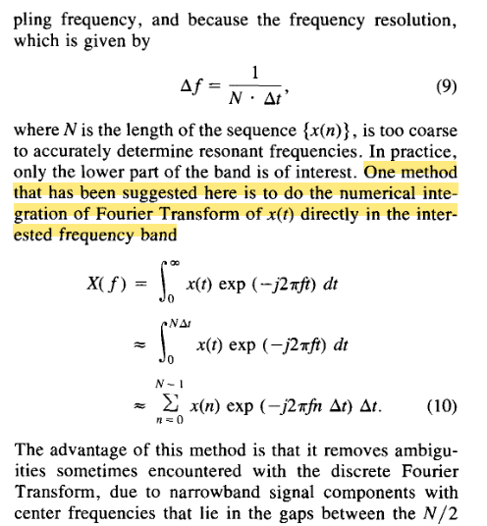
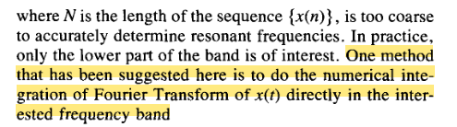
Bi et al 1992. 10.110922/.149539
“Oh, you don’t need the whole thing? Just do the part you want.”

Slide 31
https://dsp.stackexchange.com/questions/9251/fft-for-a-specific-frequency-range
“This is a more direct and exact method of calculating a spectral zoom as opposed to zero padding a DFT and interpolating to desired point locations.”
Martin, Grant. 2005. “Chirp Z-Transform Spectral Zoom Optimization with MATLAB.” SAND2005-7084, 1004350. https://doi.org/10.2172/1004350.
Notes:
Googled it.

Slide 32

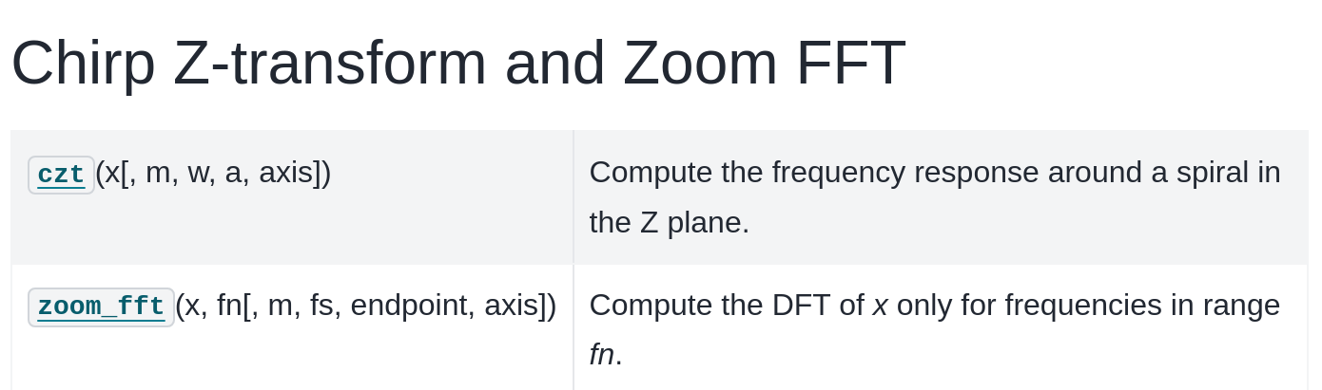

Contributed to SciPy 1.8.0 (2022), original code by Paul Kienzle from NIST and pulled in by Nadav Horesh from Medtronic

Slide 33

github.com/garrettj403/CZT
Sukhoy, Vladimir, and Alexander Stoytchev. 2019.
“Generalizing the Inverse FFT off the Unit Circle.” Scientific Reports 9 (1): 14443. https://doi.org/10.1038/s41598-019-50234-9.

Slide 34
Basic algorithm only discovered in 2019
“An efficient algorithm for computing the forward chirp z-transform was described 50 years ago[1–5]. It was derived using an index substitution, which was originally proposed by Bluestein[1,5], to compute the transform...
This paper describes the first algorithm for computing the inverse chirp z-transform (ICZT) in O(n log n) time. This matches the computational complexity of the chirp z-transform (CZT) algorithm that was discovered 50 years ago. Despite multiple previous attempts, an efficient ICZT algorithm remained elusive until now.”
Sukhoy, Vladimir, and Alexander Stoytchev. 2019.
“Generalizing the Inverse FFT off the Unit Circle.” Scientific Reports 9 (1): 14443. https://doi.org/10.1038/s41598-019-50234-9.
Notes:
We often tukey’s work 60 years ago

Slide 35
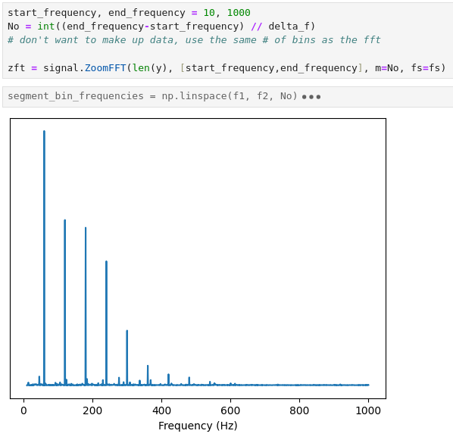

Slide 36
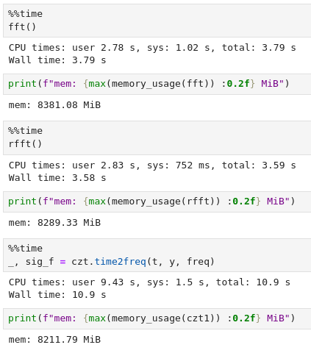
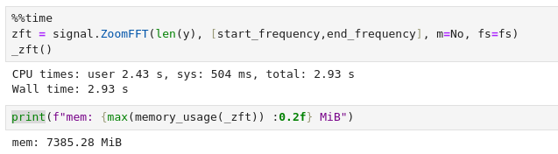

Slide 37
Thanks for your patience :)

Slide 38
Bonus Laplace Transform content
The PID loop is a conspiracy by Big Control to keep the masses docile
Notes:
The Laplace transform gives you a lot of power to build control systems that are more optimal than PID.

Slide 39
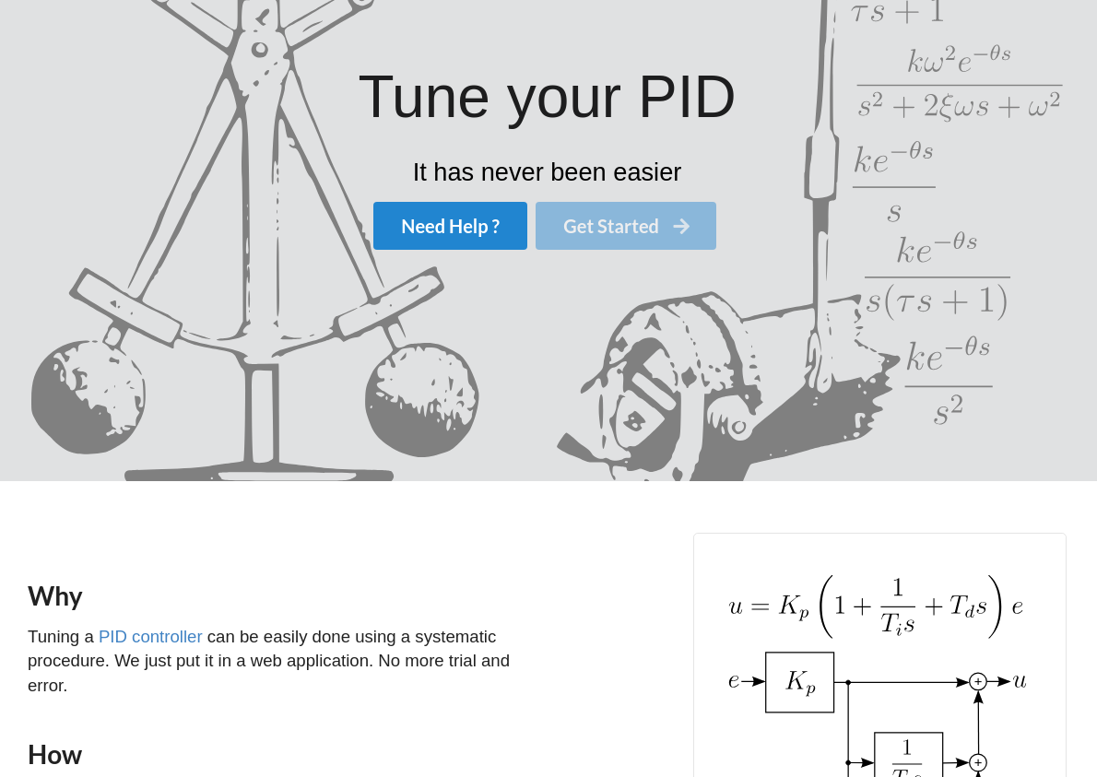
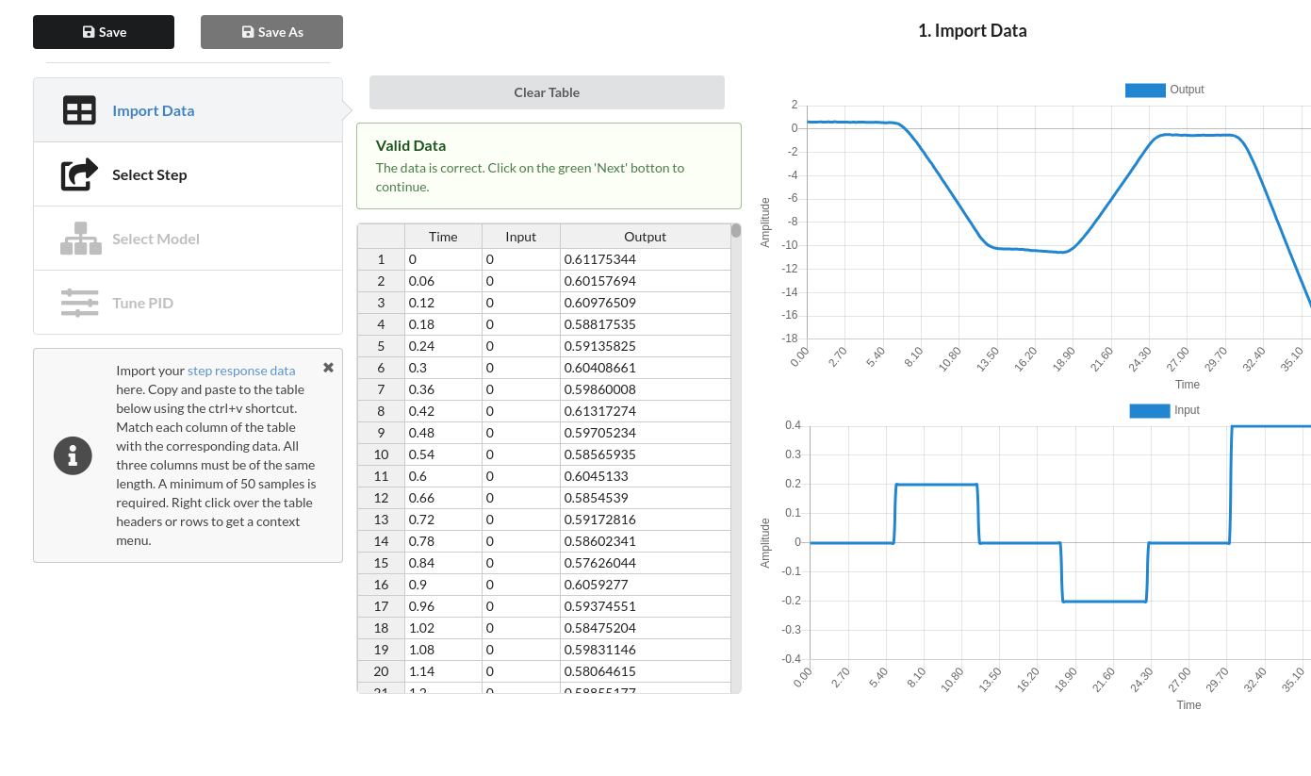
PidTuner - https://github.com/pidtuner/pidtuner.github.io.
Notes:
Great website where you could upload a step response recording of your system and get optimal PID coefficients.

